Slide 1

HLS BASED SIGNAL CLASSIFICATION SYSTEM USING DEEP NEURAL NETWORKS
GOVERNMENT COLLEGE OF TECHNOLOGY
COIMBATORE – 13
(An Autonomous Institution Affiliated to Anna University)
BE ECE - Semester VII
PROJECT GUIDE :
DR. G. SUCHITRA
ASSOCIATE PROFESSOR
Department of ECE
Government College of Technology , CBE - 13
TEAM MEMBERS :
Chandrasekar S M - 2014104
Pranav S - 2014126
Sandeep Singh - 2014128
Suriya N - 2014134

Slide 2
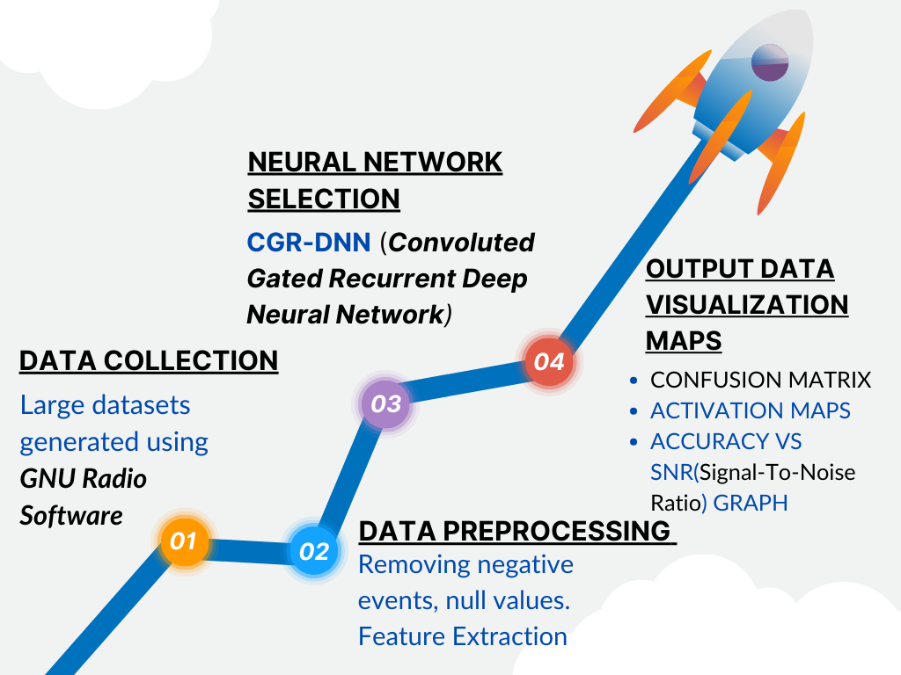
WHOA!
FLOW CHART
FLOW CHART
This can be the part of the presentation where you introduce yourself, write your email…

Slide 3
Background and Motivation
Economic and Technological Imperative:
The importance of connectivity continues to escalate, amplifying demands on wireless communication technologies. Frequency spectrum has emerged as a highly sought after and costly resource, with large corporations investing substantially for exclusive access rights. Despite heavy investment, substantial portions of the spectrum remain underutilized due to static spectrum management practices.
Cognitive Radio (CR)( A Paradigm Shift ):
Proposed by Joseph Mitola III in 1998, CR introduces dynamic spectrum management to enhance efficiency by enabling radios to sense and utilize unused spectrum intelligently. CRs dynamically adjust to their environment, selecting transmission channels and parameters autonomously—a leap towards fully uncoordinated networking.
Deep Learning as a Catalyst:
The advent of Deep Learning (DL) has reinvigorated interest in realizing practical CR systems. DL, a cutting-edge subfield of AI, employs neural network models to infer insights from unseen data, showing great potential in improving communication technologies.

Slide 4
4. Practicality and Application:
The challenge lies in transitioning DL models from theory to practice, specifically integrating them into existing digital signal processing systems predominantly based on ASICs and FPGAs. The power efficiency and sequential instruction set of CPU/GPU platforms are typically unsuitable for on-field digital signal processing, necessitating a novel approach.
5. Research and Development (R&D) in Communication:
R&D efforts are increasingly exploring machine learning (ML) and DL for wireless networks, with applications ranging from resource allocation to Dynamic Spectrum Access (DSA). This shift is further underscored by the burgeoning research in preparation for 6G networks.
6. Automatic Modulation Classification (AMC):
AMC is critical for effective information transmission, with cognitive radio leveraging AMC to optimize DSA. Existing AMC methods are computationally intensive or lack scalability across diverse modulation schemes. DL offers a promising alternative for AMC, requiring no predefined signal information and capable of handling multiple modulation formats with minimal complexity.

Slide 5
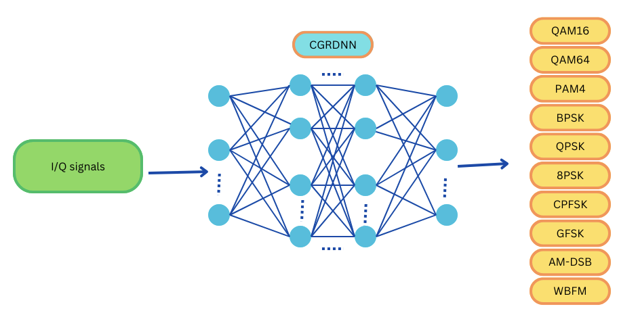
PROJECT OVERVIEW
The Signal Classification System is a Neural network based Artificial Intelligent system used to classify the received modulated signals according to the modulation technique.
Such a system is highly trained to classify even the noise affected signals that are received for applying the suitable demodulation techniques.
HARDWARE:-
This system can be implemented in an FPGA BOARD so that it can act as an Artificial Intelligent Block in a communication system.

Slide 6
STAGE 1
(DATA COLLECTION AND DATA PREPROCESSING)

Slide 7
DATASETS FOR TRAINING AND TESTING
For the training and testing of the Neural Network, there are two different datasets that were used in this signal classification system . They are
RML2016.10a_dict . dat
RML2016.10b . dat
RML stands for Radio Machine Learning . It is an extensive and an elaborate collection of the different types of the modulated signals which are affected with different types of the channel noises.
The signals in the dataset are in their original form with two different components in them. They are,
1) In-phase Components and
2)Quadrature Components

Slide 8
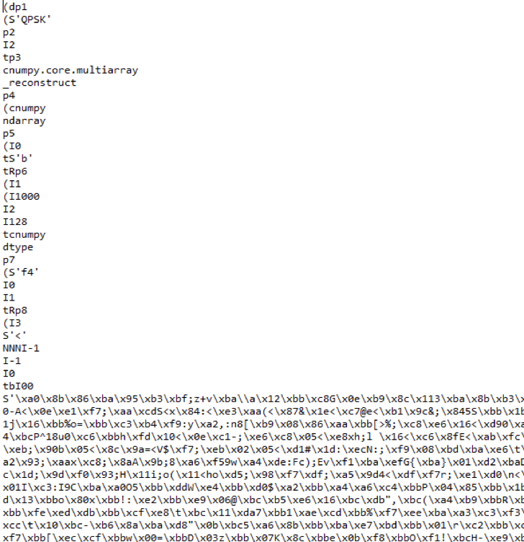
DATASET – RML2016.10a
In 2016,the DeepSig company published their first datasets determined for modulation classification.
Signals in the datasets are synthetic and were generated with GNU Radio software. To simulate real-life scenarios, channel model blocks, consisting of sample rate offset, center frequency offset, selective fading, and additive white Gaussian noise, were added. As a final step, the data were scaled to unity energy as a prior step to further usage of the dataset in the machine learning field.

Slide 9
REPRESENTATION :
The data are represented as 2x128 vectors of in-phase and quadrature signals (I/Q). They were generated for various signal-to-noise ratios (SNRs) in the range from -20 dB to 18 dB.
Why I/Q Signals?
It enables signals to be displayed as two-dimensional points on a constellation diagram, aiding in the analysis and differentiation of modulation types.
The use of both I and Q components allows for a higher density of data points within the same bandwidth, enhancing spectral efficiency.
Constellation diagrams provide insight into a signal’s robustness against noise and the trade-off between data density and error resilience.
IQ representation simplifies the process of signal detection and demodulation, making it more efficient and suitable for deep learning applications.
It supports advanced modulation methods such as QAM and PSK, crucial for modern communications, by facilitating accurate representation and decoding of complex signal types.

Slide 10
MODULATIONS AVAILABLE : (11 Modulation techniques)
BPSK, QPSK, 8PSK, QAM16, QAM64, CPFSK (Continuous phase FSK), GFSK (Gaussian FSK), PAM4, AM-DSB, AM-SSB, WBFM (Wideband Frequency modulation)
SAMPLES :
The dataset consists of nearly 220,000 samples of modulated signals with a signal to noise ratio ranging between
-20 dB and 18 dB.
Each data sample consists of two vectors, each with 128 elements i.e,each vector has a length of 128. These vectors represent the discrete samples of the in-phase (I) and quadrature (Q) components of a signal, which together form the complex representation of the RF signal
CHANNEL PARAMETERS :
FADING – Rician and Rayleigh Fading Channels, Selective Fading
NOISES – AWGN , WGN , Random noises
OFFSETS – Sample rate offset and center frequency offset

Slide 11
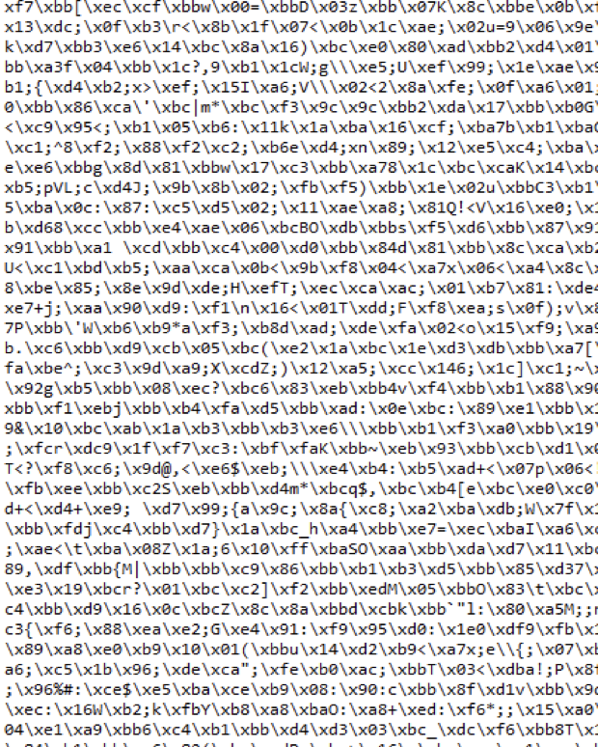
DATASET – RML2016.10b
2016.10b is yet another dataset that was generated through the same manner yet it consists of even more data samples. The Rml2016.10b has signals that are modulated in 10 different modulation techniques with GNU to mimic the actual surroundings of the environment dealing with the real time noises in fading channels.
REPRESENTATION :
The data are represented as 2x256 vectors of in-phase and quadrature signals (I/Q). They were generated for various signal-to-noise ratios (SNRs) in the range from -22 dB to 18 dB.

Slide 12
MODULATIONS AVAILABLE : (10 Modulation techniques)
BPSK , QPSK , 8PSK
QAM16 , QAM64 ,
CPFSK (Continuous phase FSK)
PAM4
AM-DSB , AM-SSB , WBFM (wide band Frequency modulation)
CHANNEL PARAMETERS :
FADING – Rician and Rayleigh Fading Channels
Selective Fading
NOISES – AWGN , WGN , Random noises, BSC Noises
OFFSETS – Sample rate offset and center frequency offset
SAMPLES :
The dataset consists of nearly 1,200,000(1.2 million) samples of modulated signals with a signal to noise ratio ranging between
-22 dB and 18 dB.

Slide 13
CHALLENGES FACED
Modern Communication uses IQ Signals. Hence, we need to collect Data of IQ Signals with varying modulation techniques and noise effects.
Our current Dataset was created by DeepSig, which works on using Machine Learning Algorithms for Wireless Signal Processing.
The Current Dataset was created in 2016, containing only 11 Classes of Modulation Techniques, on which our model has trained.
This dataset was created for early academic research work. There is a bigger dataset, RADIOML 2018.01A, which includes both synthetic simulated channel effects of 24 digital and analog modulation types which has been validated.

Slide 14
STAGE 2
(NEURAL NETWORK SELECTION)

Slide 15
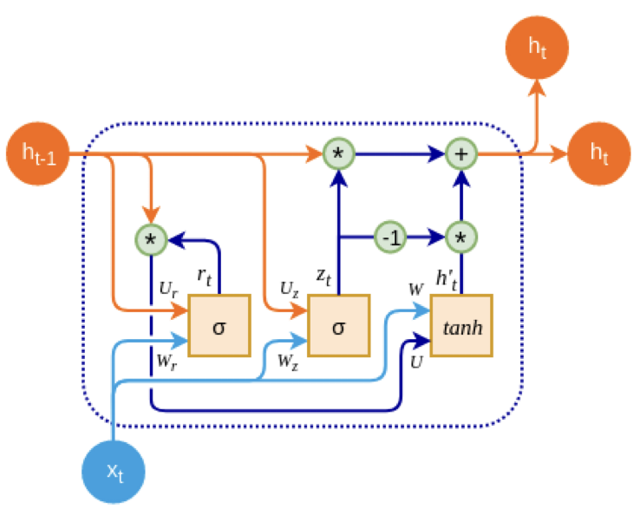
NEURAL NETWORK ARCHITECTURE
Neural Network used for this signal modulation classification system is CGR-DNN.
It stands for Convoluted Gated Recurrent Deep Neural Network.
It is a hybrid neural architecture that is a modification of the common DNN. It consists of a Gated Recurrent Unit ( GRU ) followed by a Gaussian Dropout layer in between the 1D convolution layers.
WHY THIS?
it has very less nodal parameters
the accuracy of the output is better than regular DNN.

Slide 16
Why not DNN (Deep Neural Network)?
CGR-DNN can achieve better accuracy compared to this.
Requires more time for training datasets.
Hls implementation problems like environment path setting
Not compatible for wide range of signal modulation schemes (does not support ).
Version compatibility.

Slide 17
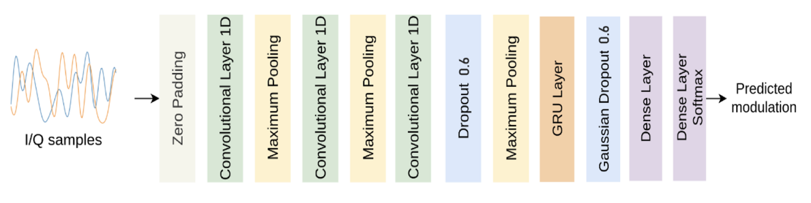
NEURAL NETWORK ARCHITECTURE

Slide 18
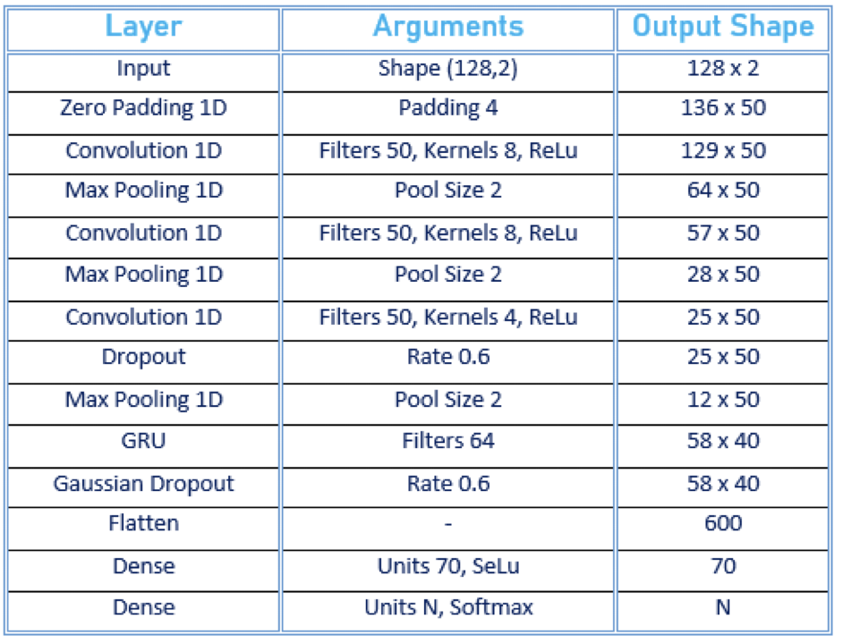
CGR-DNN LAYERS AND SIZES

Slide 19
STAGE 3
(TRAINING THE MODEL-most crucial stage)

Slide 20
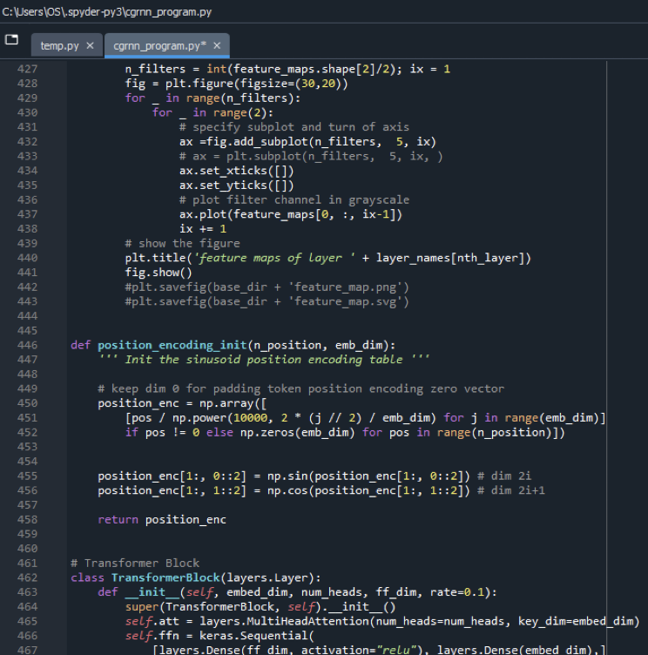
PYTHON CODE AND OUTPUTS
The neural network program is written in python 3.11 programming language in a python IDE called ‘ Spyder 3.1 ’.
The dataset is split into three subsets for Training, Validation and Testing respectively.
Training data subset - 70 %
Validation data subset - 15 %
Testing data subset - 15 %
The python program runs, processes and classifies the I/Q signal data and produces several program evaluation metrics for understanding the efficiency of the signal classification.

Slide 21
Challenges faced for training the model
process of training the model requires significant computational resources, both in terms of processing power (CPU ) and memory.
Finding the optimal set of hyperparameters for the model was challenging.
Required larger datasets.
DeepSig has created a newer dataset RadioML 2018, which includes both synthetic simulated channel effects of 24 digital and analog modulation types which has been validated with 2 million examples, each 1024 samples long.

Slide 22
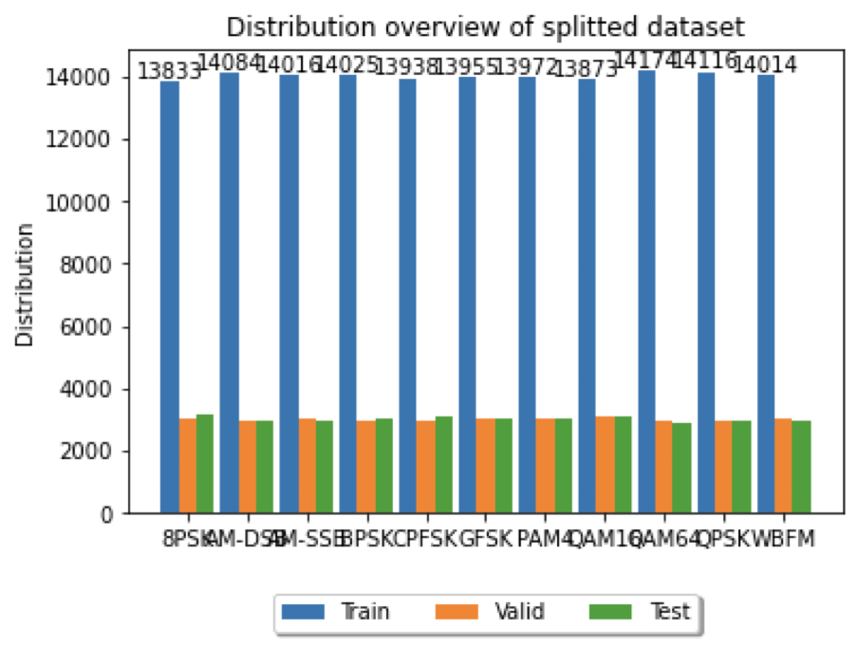
DATASET SPLIT UP
15%-VALIDATION
15%-TESTING
75%-TRAINING

Slide 23
Training Set:
Testing Set:
Validation Set:
Large portion of datasets is used to train the model.
Mainly used for Optimization of the model parameters.
It is used to assess the final performance of the model.
provide an unbiased evaluation of its ability to generalize to new, unseen data.
Smaller portion of data.
It helps in tuning hyperparameters, preventing overfitting, and assessing the model's generalization to unseen data.

Slide 24
STAGE 4
(DATA VISUALIZATION)

Slide 25

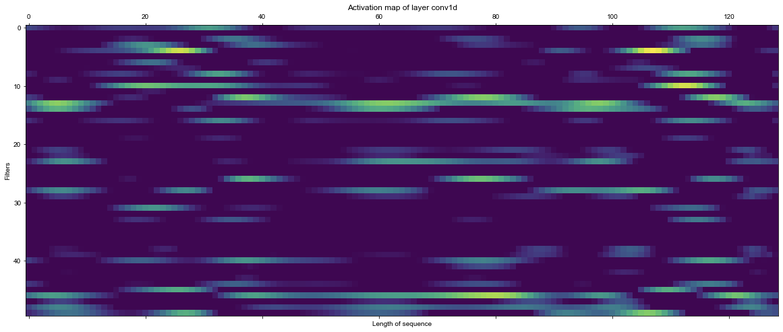
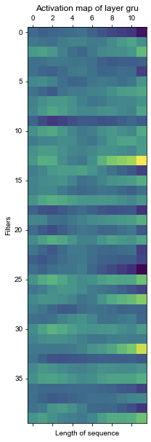
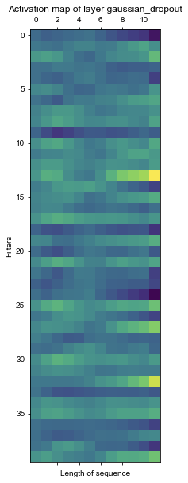
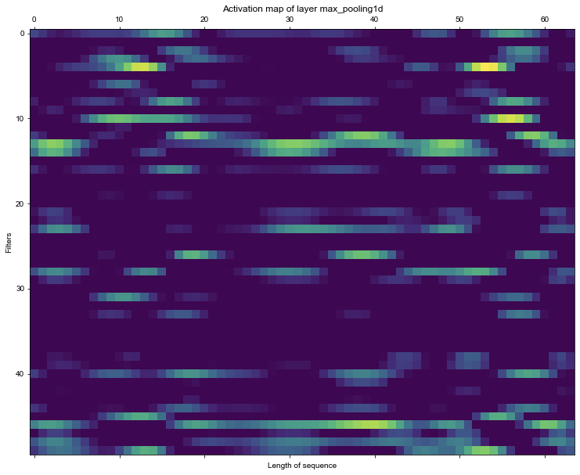
ACTIVATION MAPS- (various layers)
Zero Padding Layer
Convolution Layer
GRU Layer
Gaussian Dropout Layer
Max Pooling Layer

Slide 26
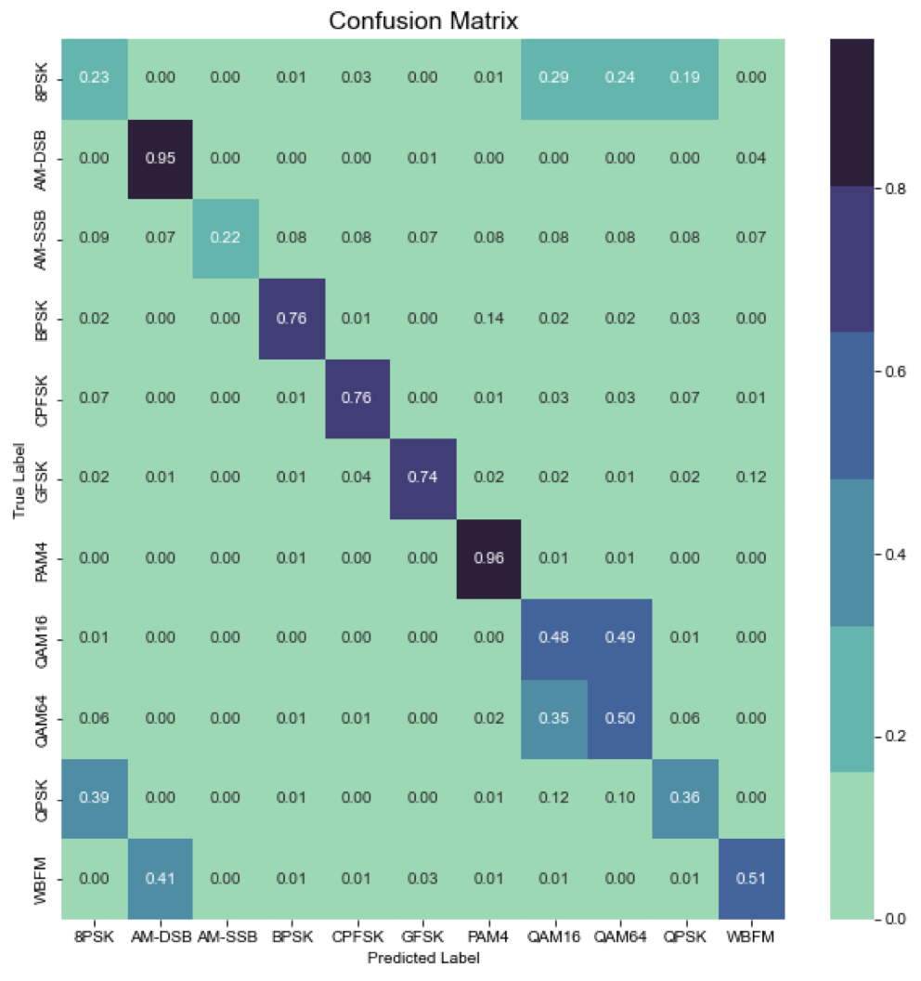
OUTPUT CONFUSION MATRIX

Slide 27
OUTPUT CONFUSION MATRIX
It is one of an evaluation metrics that deduces “relationship between actual values and predicted target values”.
For eg:- In AM-DSB, 95% is the correct prediction rate.Here, we compare, AM-DSB from actual values( y-axis) and predicted values( x-axis).
QAM-64 contains at the core, same constellation points as the QAM-16 and since the signals can contain similar features, the classifier might find it harder to tell the QAMs apart.( QAM )

Slide 28
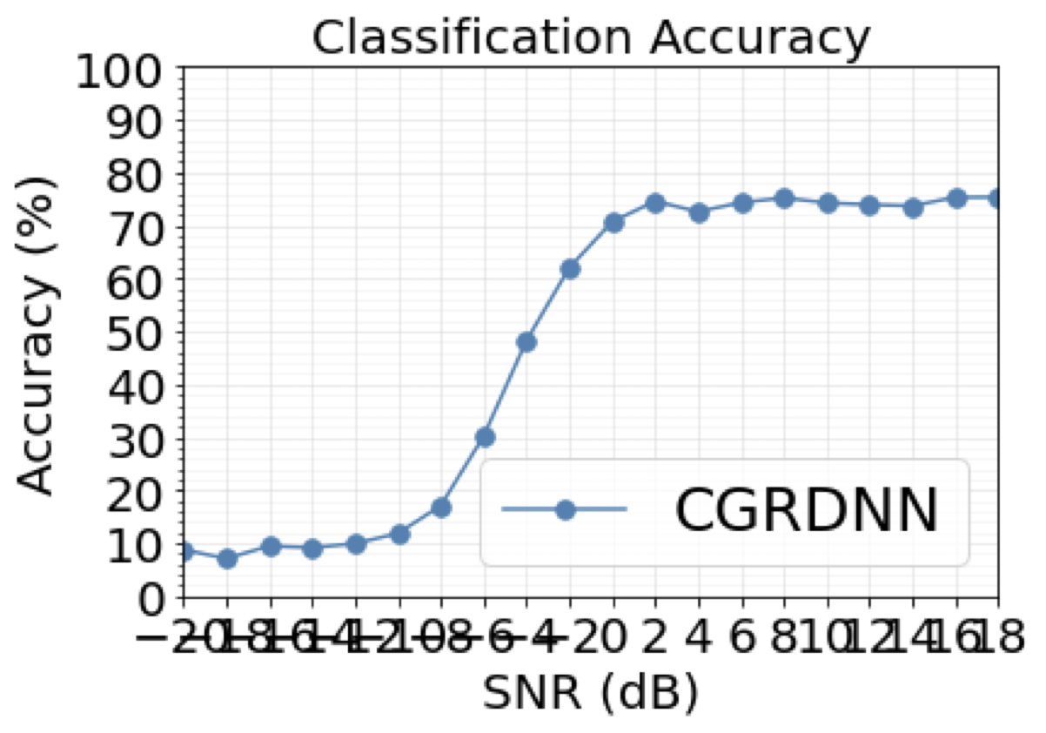
ACCURACY VS SNR GRAPH

Slide 29
ACCURACY VS SNR SIGNIFICANCE
Within contemporary base stations, a multitude of data streams are concurrently transmitted at varying levels of power.
The challenge of proportionally allocating transmission power escalates with the rise in user count, imposing a cap on the number of manageable data streams.
Our system’s inherent reconfigurability, alongside its capability to achieve high classification accuracy operating at a modest 6dB signal-to-noise ratio (SNR), enables the accommodation of an increased volume of data streams at reduced power levels, thereby amplifying user support.
Additionally, the system’s proficiency in maintaining accurate classification at 6dB suggests enhanced tolerance to interference even when operating at elevated transmission power settings.

Slide 30
INNOVATION FACTOR-HLS4ML
High Level Synthesis for Machine Learning (HLS4ML) Implementation:-
Train machine learning model and implement it on FGPA( Field Programmable Gated Array )

Slide 31
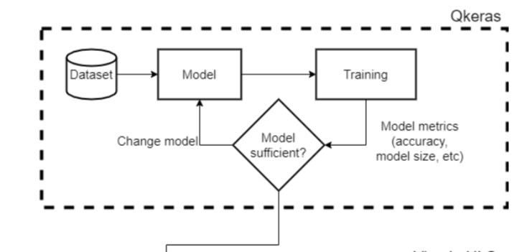
HLS IMPLEMENTATION BLOCK DIAGRAM

Slide 32
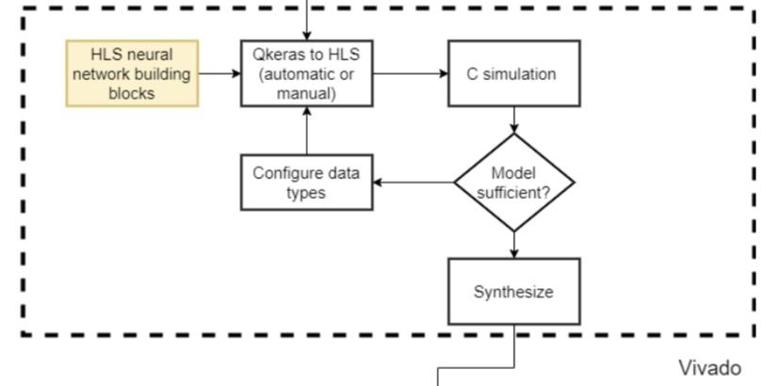

Slide 33
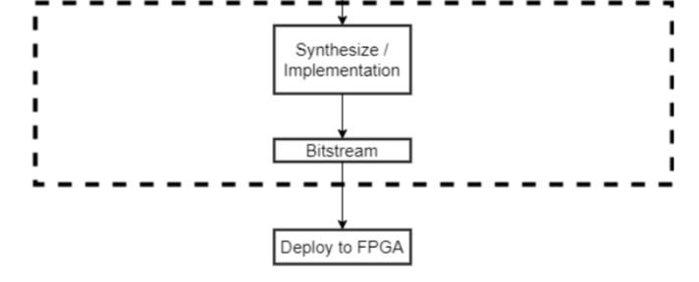

Slide 34
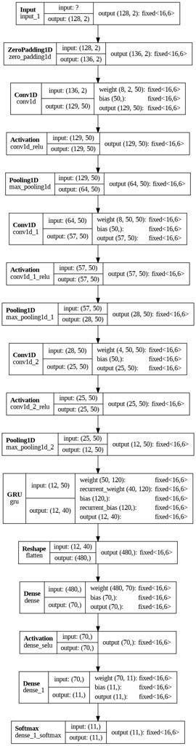
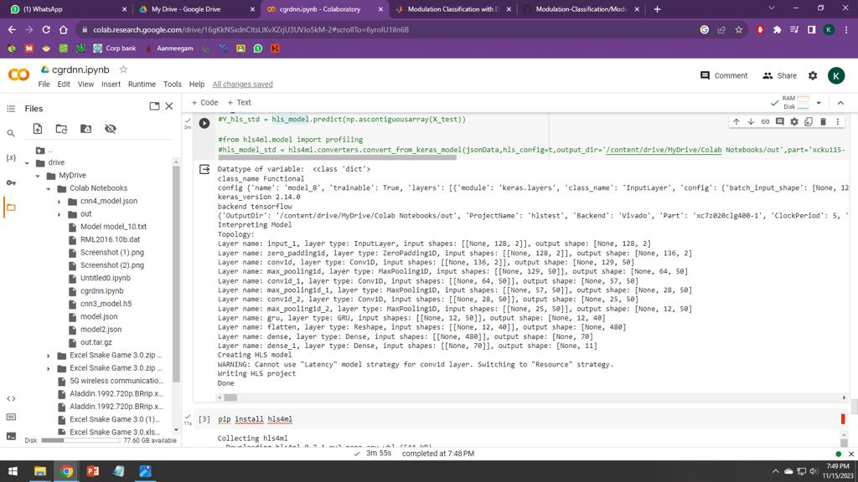
HLS OUTPUTS
HLS Layer model plot
HLS Model Compiling

Slide 35
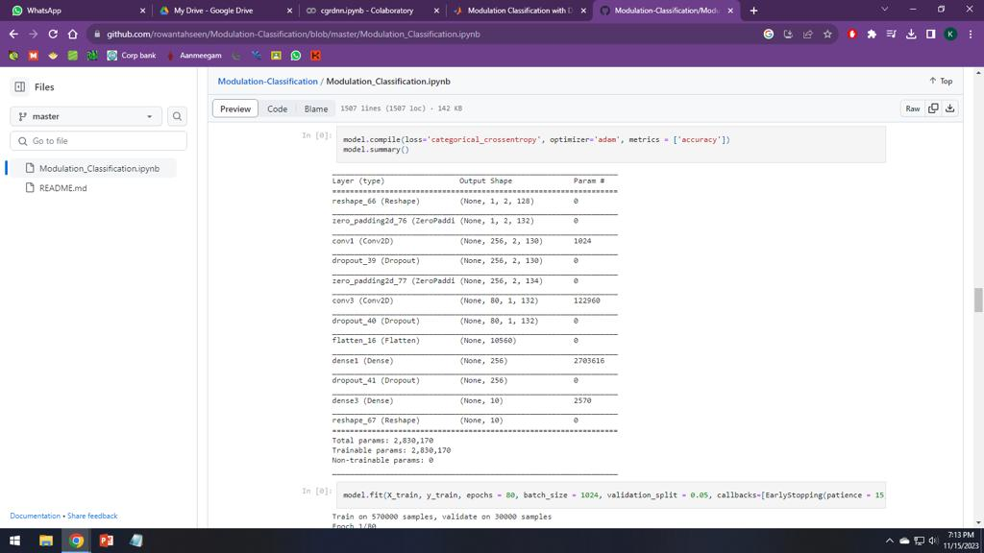
EXISTING CNN (MODEL PARAMETERS)- MORE(2,830,170)

Slide 36
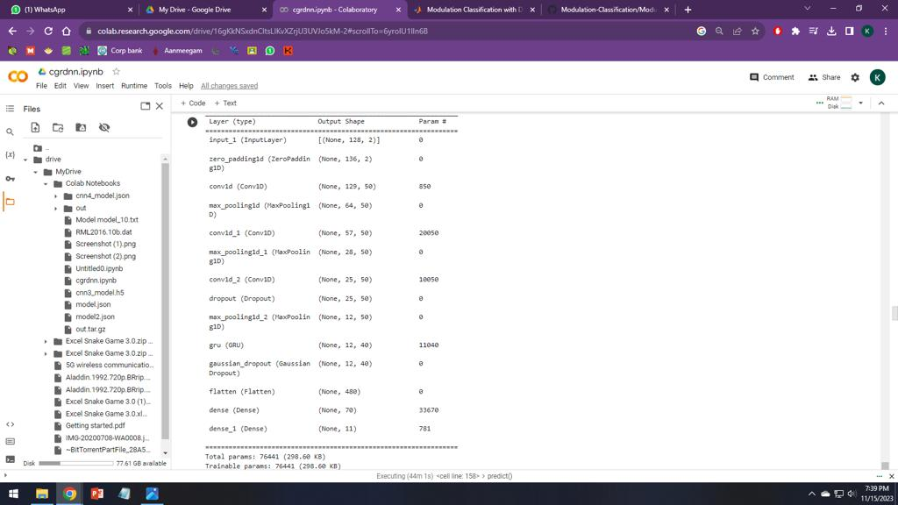
OUR CGR-DNN (MODEL PARAMETERS) - LESS(76,441)

Slide 37
PRACTICAL APPLICATIONS
It is used in non-cooperative channel communication scenario, there comes a need to recognize and classify the modulation format of the received signals to identify the communication targets and to have better management over them.
To solve problems such as,
high complexity,
low accuracy
hard process of manual extraction of signal features, we can go for a Deep Neural Network based modulation format identification block so that we can effectively classify received signals and apply specific demodulation technique to it.

Slide 38
The proposed project will implement such a Neural Network to advanced 4G and 5G modulated signals and implement it on an FPGA board using High Level Synthesis for Machine Learning (hls4ml) concept.
Furthermore, this signal classification system is more important in MANET and VANET networks and SIGINT applications.

Slide 39
REFERENCE
A survey of modulation classification using deep learning: Signal representation and data preprocessing. S Peng, S Sun, YD Yao , IEEE 2017.
Meng, P.F.; Chen, L.; Wu, X.W. Automatic modulation classification: A deep learning enabled approach. IEEE Trans. Veh. Technol. 2018, 67, 10760–10772.
Automatic modulation classification based on constellation density using deep learning Y Kumar, M Sheoran, G Jajoo , IEEE 2020.
Li, Y.; Wang, B.; Shao, G.; Shao, S. Automatic modulation classification for short burst underwater acoustic communication signals based on hybrid neural networks. IEEE Access 2020, 8, 227793–227809.

Slide 40
A Review of Research on Signal Modulation Recognition Based on Deep Learning by Wenshi Xiao, Zhongqiang Luo and Qian Hu
HLS-Based FPGA Implementation of Convolutional Deep Belief Network for Signal Modulation Recognition by Jian Zhao, Yaqin Zhao, Hongbo Li, Yun Zhang and Longwen Wu , IEEE 20465005
Ultra-low latency recurrent neural network inference on FPGAs for physics applications with hls4ml by Elham E Khoda, Dylan Rankin, Rafael Teixeira de Lima

